Slide 1

Mastering Prompt Engineering
Unlock the full potential of AI with effective communication.

Slide 2
The Foundation: Fundamental Prompting Techniques
Explore essential methods to guide AI responses, from direct questions to structured examples.
01
02
03
Zero-Shot Prompting
One-Shot Prompting
Few-Shot Prompting
Direct queries without examples for simple, clear tasks.
A single example to define desired response format.
Multiple examples to establish complex patterns and nuanced outputs.

Slide 3

Zero-Shot Prompting: The Direct Approach
The simplest way to interact: ask directly when the AI already possesses clear domain knowledge.
Classify this movie review as positive, negative, or neutral: "The film was visually stunning but the plot felt rushed."
When to Use:
Simple, well-defined tasks
When the model has clear knowledge of the domain
Quick, one-off requests

Slide 4
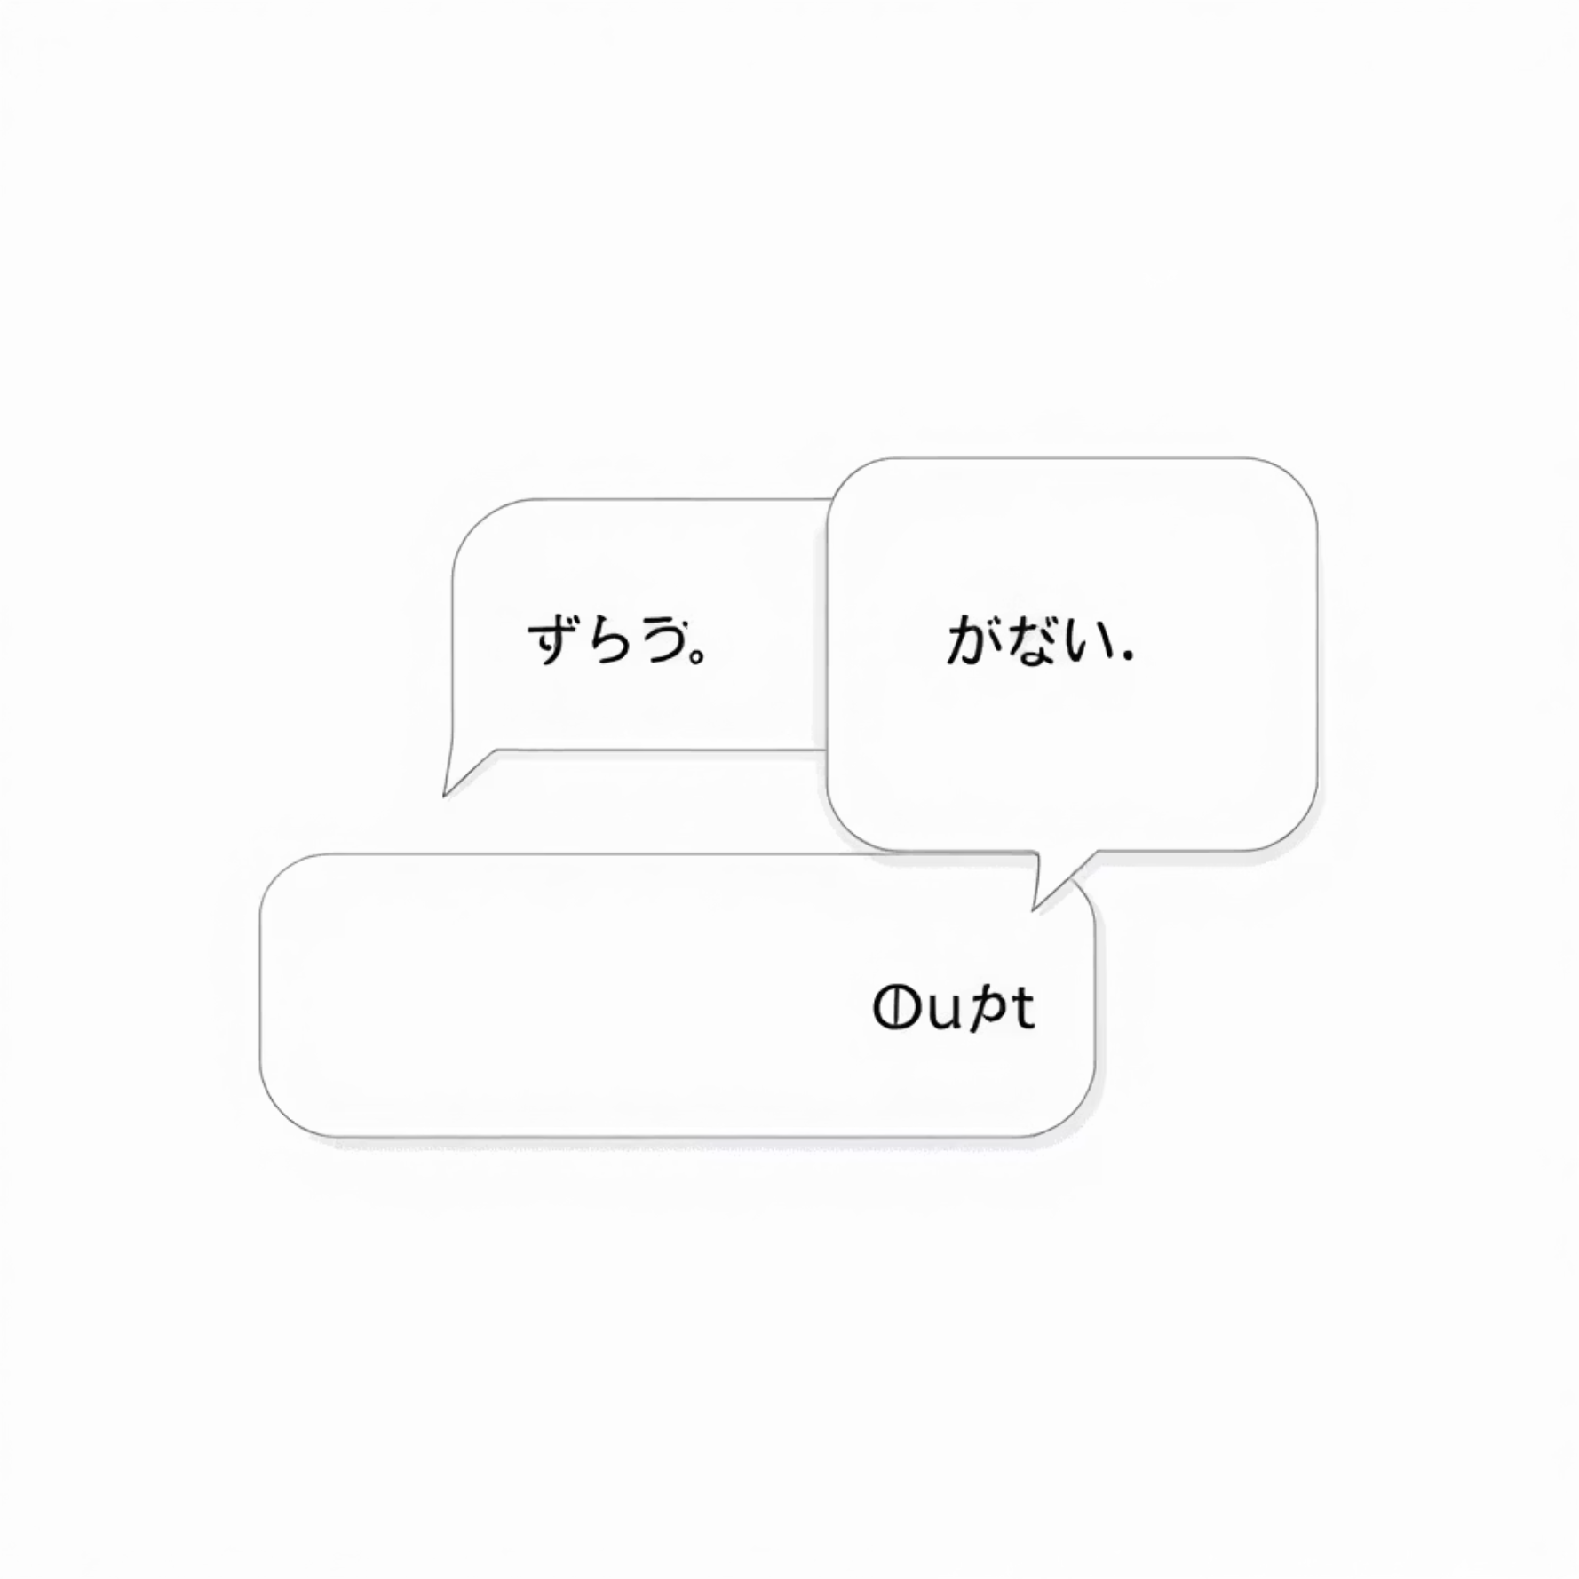
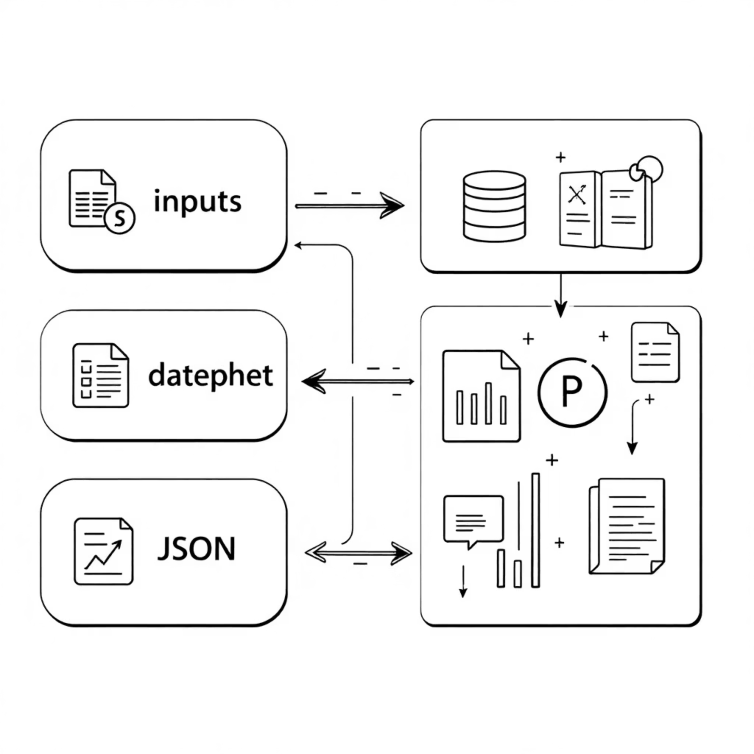
One-Shot & Few-Shot Prompting: Learning from Examples
Guide the AI's understanding and response format by providing illustrative examples.
One-Shot: Single Example Clarity
Few-Shot: Pattern Recognition
Provide one example to define the desired output format or task.
Use multiple examples to establish a clear pattern for more complex tasks.
Translate English to French: English: "Hello, how are you?" French: "Bonjour, comment allez-vous?" English: "Where is the library?" French:
Convert customer feedback to structured data: Feedback: "Great service, but food was cold" JSON: {"service": "positive", "food": "negative", "overall": "mixed"} Feedback: "Terrible food and rude staff" JSON:
Use 3-5 high-quality, diverse examples.
Ensure consistency and mix up classes for classification.

Slide 5

Shaping AI Behavior: System & Role Prompting
Define the AI's persona, overall context, and behavioral guidelines for consistent interactions.
System Prompting
Role Prompting
Set overall context and persistent behavior guidelines.
Assign a specific character or expertise to the AI.
You are a helpful travel guide. Provide practical, accurate information about destinations.
Act as an experienced software architect. I need help designing a scalable web application.

Slide 6

Contextual Prompting: Guiding with Background
Provide specific background information to ensure the AI's response is relevant and tailored.
Example Scenario:
Context: You're writing for a tech blog aimed at beginners who have never coded before. Write a 200-word explanation of what an API is, using simple language and practical examples.
This technique grounds the AI's output, making it highly applicable to the specified audience or situation.

Slide 7

Advanced Strategies: Reasoning for Complex Problems
Tackle intricate challenges by encouraging the AI to think step-by-step or explore multiple solutions.
Step-Back Prompting
Self-Consistency
Ask a general question first to establish context, then specific questions.
Chain of Thought (CoT)
Generate multiple reasoning paths and select the most common answer for reliability.
Encourage step-by-step reasoning for math, logic, and multi-step processes.

Slide 8

Chain of Thought (CoT): Thinking Step-by-Step
Break down complex problems, guiding the AI through logical progression for accurate solutions.
Solve this step by step: If I was 6 when my sister was half my age, how old is my sister when I'm 40? Let me think through this step by step:
Best Practices:
Use phrases like "Let's think step by step."
Set temperature to 0 for consistent reasoning.
Extract final answers separately from reasoning.

Slide 9




ReAct & Tree of Thoughts: Combining Action and Exploration
These powerful strategies enable AI to reason, act on external information, and explore diverse solutions.
ReAct (Reasoning + Acting)
Action
Interleaves reasoning (Thought), actions (Action), and observations (Observation) to solve problems.
Utilizes tools or external data (e.g., web search) based on reasoning.
Tree of Thoughts (ToT)
Observation
Explores multiple reasoning branches simultaneously, evaluating each for creative problem-solving.
Processes the results from actions to refine subsequent steps.

Slide 10


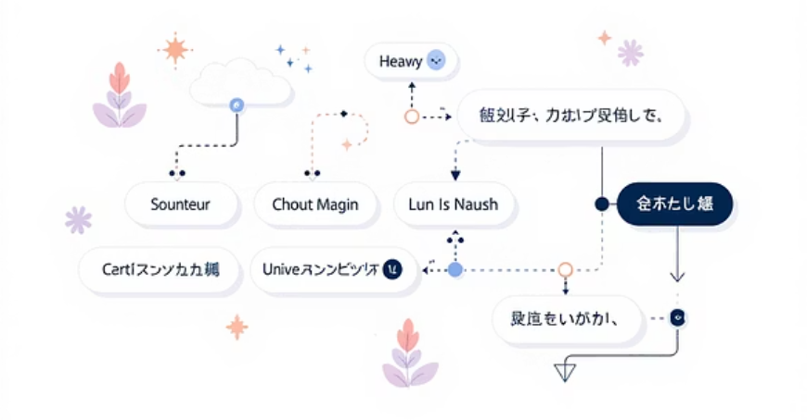
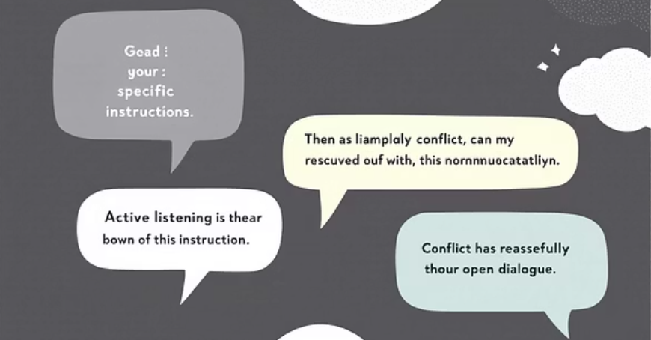
Prompt Engineering: Best Practices for Impact
Craft effective prompts to maximize AI utility and ensure precise, desirable outputs.
Be Specific & Clear
Provide precise instructions, avoiding vague language.
Use Action Verbs
Explicitly state the desired action (e.g., Analyze, Summarize, Generate).
Provide Examples
Illustrate expectations with clear, consistent examples.
Structure Your Prompts
Use clear formatting: Task, Context, Format, Example.
Iterate & Document
Refine prompts based on results and keep a record of successful patterns.

